Slide 1
Uranus

Slide 2
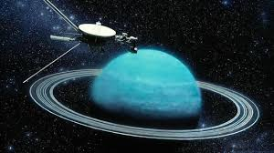
Where in the solar system is it ?
Uranus is the 7th planet from the sun.
Strangely, one probe has gone past uranus. the probe was called voyager 2 and it was going around the solar system to visit Neptune.
Uranus is in between saturn and neptune approximately 2.8 billion km away from earth.

Slide 3
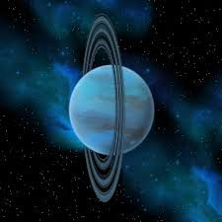
What are its key features?
Uranus has tons of moons. Its rings are not like others because they are almost impossible to see.
Uranus has many moons; these include oberon, Titania and miranda.

