Slide 1
KS1 Maths Workshop
Steph Scott – Maths Leader and Year 4 Teacher
Sophie Parish – Year 2 Teacher

Slide 2
New curriculum
New curriculum introduced in 2014
2016 first year of new SATs
Higher expectations
More focus on fluency, problem solving and reasoning

Slide 3
Term | Year 1 | Year 2
Autumn 1 | Number and place value Addition and subtraction | Number and place value Addition and subtraction
Autumn 2 | Geometry Number and place value Addition and subtraction | Measures(Length and Mass) Statistics Multiplication and Division
Spring 1 | Number and place value Time Length and height Addition and subtraction | Money Geometry
Spring 2 | Multiplication and division Fractions | Fractions
Summer 1 | Number and place value Four operations | Time Capacity, volume and temperature Four operations
Summer 2 | Money Weight and Volume | Four operations Position and direction

Slide 4
Connective Model
Symbols
Vocabulary
Models and images
Apparatus and real world context

Slide 5
Resources
Numicon
Beadstrings
Base 10
Counters
Cubes
Numberlines
100 squares
Place value arrow cards

Slide 6
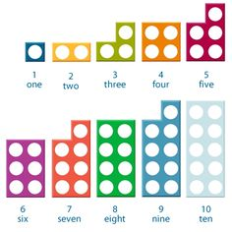
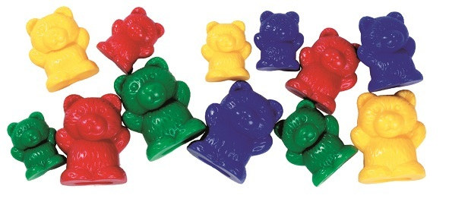
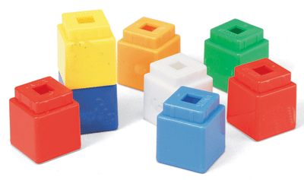
Addition in KS1
Children start by using a range of different resources to count and add

Slide 7
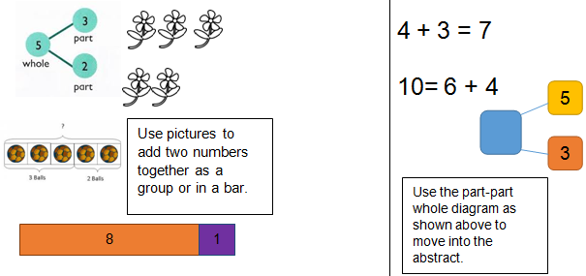
Addition in KS1
We introduce them to the part-part whole model.

Slide 8
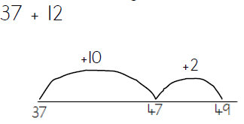
Addition in KS1
Learning to add on a number line

Slide 9
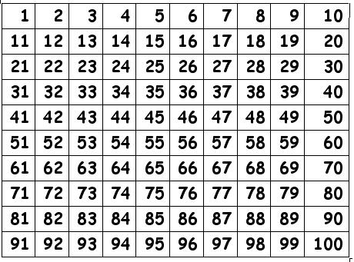
Addition in KS1
Addition using a 100 square

Slide 10
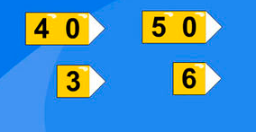
Addition in KS1
Children learn to partition numbers into hundreds, tens and units. This then becomes another method for addition.

Slide 11
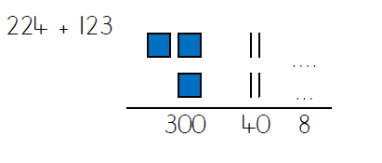
Addition in KS1
Learning to draw pictorial representations of dienes/base 10.
Using pictorial representations in a column format.

Slide 12
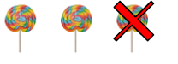
Subtraction in KS1
Taking away
Finding the difference

Slide 13
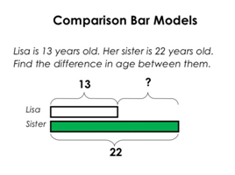
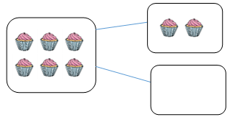
Subtraction in KS1
Using bar models, or part-part whole models, to understand taking away, finding the difference and inverse operations.

Slide 14
Subtraction in KS1
Solve using inverse operations (part-part whole models)
E.g. 6 + ? = 10
Counting back using fingers, cubes, beadstrings, numicon.
Using partitioning skills, numberlines to count back, 100 squares

Slide 15
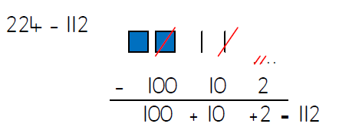
Subtraction in KS1
Subtracting using dienes as pictorial representations

Slide 16
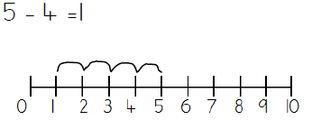
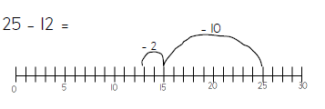
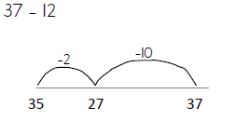
Subtraction in KS1
Subtraction on a numberline

Slide 17
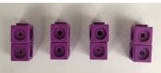
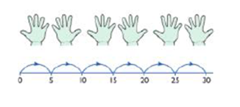
Multiplication in KS1
Children learn to count in 2s, 5s and 10s.
Learn to count objects which are already grouped
Pairs of socks
5p coins
Dienes blocks

Slide 18
Multiplication in KS1
Children understand multiplication as repeated addition.
Y1 curriculum does not expect children to know the x symbol.

Slide 19
Multiplication in KS1
Children record in an array
4 x 5
4 + 4 + 4 + 4 + 4

Slide 20
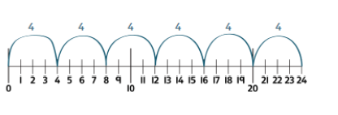
Multiplication in KS1
Children calculate using repeated addition on a number line for tables they don’t know by heart.
Children expected to know their 2, 5 and 10 times tables.
Children need to be able to count on from any number in 2s, 3s, 5s or 10s.

Slide 21
Multiplication in KS1
Children begin to learn that numbers can be partitioned in order to multiply easily.
Children show this using arrays and base 10.
E.g. 4 x 10 is the same as 2 x 10 + 2 x 10
2 x 10
2 x 10

Slide 22
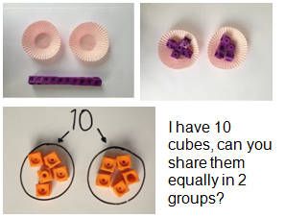
Division in KS1
Children begin to learn about sharing and grouping.
Sharing:
Sharing out into a set number of groups to work out how many will be in each group.
Grouping:
Putting into groups of set amounts to work out how many groups there will be.

Slide 23
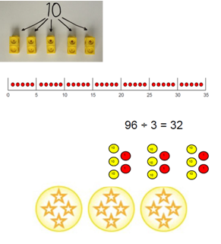
Division in KS1
Children use beadstrings, cubes, counters, base 10 etc to aid their calculations.
Children are not introduced to the ÷ symbol until year 2

Slide 24
Division in KS1
Division is understood as the inverse of multiplication.
12 ÷ 4 is understood as ‘How many 4s in 12?’
In KS1 children expected to be able to solve practical real life division problems dividing by single digit numbers.

Slide 25
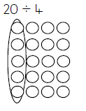
Division in KS1
Children must also understand it as repeated subtraction.
We may record as arrays and count the groups.

Slide 26
Fractions in KS1
Children learn doubling and halving in EYFS.
Children will be assessed on their fractions knowledge in the arithmetic SATs test as well as on the reasoning paper.
Need to know how to calculate halves, quarters and thirds.

Slide 27
Fractions in KS1
Fractions are taught in lots of different contexts:
Fractions of numbers
Fractions of shapes
Fractions of objects e.g. A length of ribbon
Fractions of sets of objects e.g. Pencils
Fractions of distances
Fractions on a number line
While children are still grasping the concept, lessons are very practical.

Slide 28
Fractions in KS1
Children need to recognise fractions in different forms.

Slide 29
KIRFs
Key Instant Recall Facts
One per half term
Practise daily to improve fluency and number facts

Slide 30
End of KS1 SATs
Arithmetic paper and reasoning paper
No concrete apparatus allowed
Not time limited
Teacher can read the questions to them on the reasoning paper.
Children will be unaware of SATs.

Slide 31
What you can do at home
Practise KIRFs
Sort, group and order things.
Practise measuring – e.g. In cooking
Find fun puzzles to solve
Play games using dice/counting. E.g. Dominoes/snakes and ladders
Look for and make patterns e.g. Make beaded bracelets with a pattern of one red, two blue
Find shapes and arrays in real life
Using the numbered cards in a pack (no picture cards), play number bond snap.
Practise telling the time, and discuss how many minutes/hours until certain events in the day.
Find symmetry in nature.
Spot odd and even house numbers on your street.
Small conversations, games, puzzles and patterns can make a big difference. They make maths relevant to the children.

Slide 32
Key Resources we use
Counters
Base 10/dienes
Numberlines
Numicon
Place value grids
Beadstrings
Many of these can be made at home.

