Slide 1
Welcome to Year 3!
Mrs Smith – Year group lead
Miss D-J – Year 3 Teacher
Pascaline – LSA
Leigh-Anne – LSA
Vicky – LSA
Thrive Enjoy Achieve Aspire

Slide 2
Thrive
Achieve
Aspire
Enjoy
Respect all Overcome challenges Open our minds Take care Speak kindly
Notes:
This image shows our tree. We have one of these trees as a display in each classroom and it forms the basis of our behaviour management system. Each child has a leaf and at the start of each session this will be on green. As children follow our roots and values, they are showing they are part of our family and part of our tree. Children who go ‘above and beyond’ will have their leaf moved to a gold bird. This earns them house points. If children are not following our roots and values, their leaf may be moved to the yellow or the red leaf until they begin to make the right choices again.

Slide 3
Our ROOTS
Respect all people, animals and the environment.
Overcome challenges and never give up.
Open our minds to creativity and curiosity.
Take care of our bodies and our minds.
Speak kindly and listen to others.
Respect all Overcome challenges Open our minds Take care Speak kindly
Notes:
These are our roots, which all children are expected to follow in our school.

Slide 4
Yellow and Red Leaves
Warning.
Not following our ROOTS.
3 yellow leaves in 1 day = red leaf.
Still not making the right choices.
Consequence and reflection.
3 red leaves in one week, or a more serious incident = lunchtime detention
Respect all Overcome challenges Open our minds Take care Speak kindly
Notes:
If children are not following our roots, they are given a verbal warning. If their behaviour continues, their leaf will be moved to yellow until they are able to follow the roots again. If a child goes down to yellow 3 times during the same day, this results in one red leaf. A red leaf may also not be given if behaviour is not improved after moving to yellow, or for serious incidents. A red leaf results in a consequence, such as some of their break being missed. Three red leaves in one week results in a lunchtime detention.

Slide 5
Rewards
Aspire trophy
Gold leaves
House points
Respect all Overcome challenges Open our minds Take care Speak kindly
Notes:
Each week, one child who has gone ‘above and beyond’ by putting a lot of effort into their learning, will be awarded the aspire trophy. This will sit on their desk for the week and they will receive 3 house points. We also award gold leaves each week for demonstrating our roots. House points are also awarded.

Slide 6
House System
Every child is either yellow, blue or green house.
Houses should match their siblings houses.
The children who follow our roots will be awarded house points. These are then totalled at the end of each term with a prize for the winning house.
Thrive Enjoy Achieve Aspire
Notes:
Children stay in the same house throughout their time at our school. This should be the same house as siblings in the school.

Slide 7
Communication
Parent Mail – ensure you are registered.
Our website – www.greatlinfordprimaryschool.co.uk
Home reading journal – checked daily. When returning books, children will put these in our classroom box or library area.
Google classroom
Call the office to make an appointment. Parents will not be allowed on site without an appointment.
Thrive Enjoy Achieve Aspire

Slide 8
Google Classroom
You will be sent your new google classroom code to access any home learning.
In the event that your family has to isolate or the class/school is shut, home learning will be shared via this platform.
In an effort to cut down on paper use, the following will now be shared via this platform:
Key Instant Recall Facts for maths
Home Learning
Weekly Spellings
Any other messages that are linked to our year group
Thrive Enjoy Achieve Aspire

Slide 9
Pupil Premium
Funding is given to schools for each child registered for pupil premium.
This funding enables us to support these pupils in any way necessary to improve their education.
This may include discounts for school trips, uniform and after-school clubs.
If you think you may be eligible to register your child as pupil premium, please speak to Carol Mallett (our family champion) or the office.
Further information about how to apply and how this funding is used at our school is on the website.
Thrive Enjoy Achieve Aspire

Slide 10
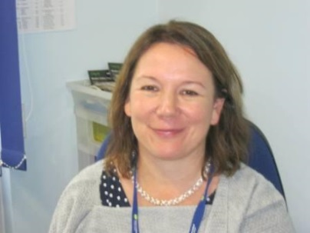
Our Protective Hands
Each child has a protective hand. It lists 5 people they can go to if they are feeling sad or worried.
Each class also has a worry box – this is checked daily.
Our designated safeguarding lead is our head teacher – Miss Lovelock.
Thrive Enjoy Achieve Aspire

Slide 11
What to do if you think your child is being bullied:
Encourage them to speak to an adult in school through use of their protective hand, the worry box in their class or by speaking directly to their teacher.
Make an appointment through the office with your class teacher to voice your concerns. All worries will be taken seriously and investigated.
Thrive Enjoy Achieve Aspire

Slide 12
Our expectations
Good attendance – 97%
Correct uniform and PE kits.
Come to school prepared
Reading journals in school every day
Read at home 5 times a week – journal signed by adults.
Practise spellings and KIRFs at home.
Doodlemaths
MyOn
Thrive Enjoy Achieve Aspire

Slide 13
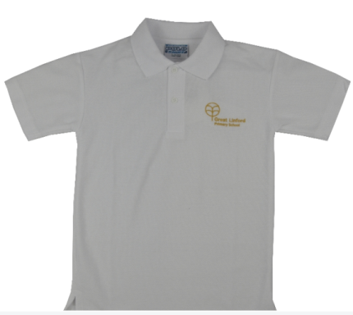
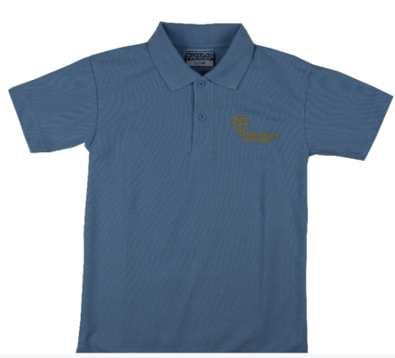
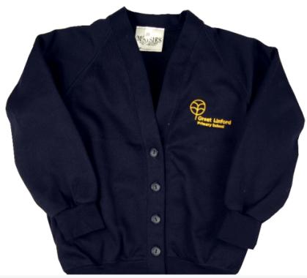
Uniform
Black/Grey trousers/skirt.
Smart black shoes (no trainers)
White or blue shirt/polo
Navy blue cardigan/jumper
No bracelets/necklaces
Earrings must be studs, not hooped.
Note: Windows must be kept open for good ventilation. For this reason, children need a school jumper every day.
Respect all Overcome challenges Open our minds Take care Speak kindly
Notes:
DM

Slide 14
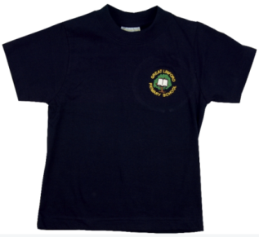
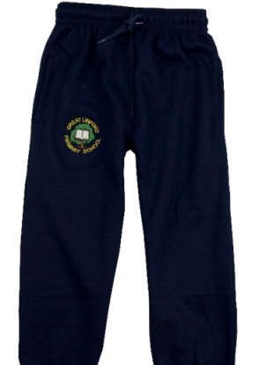
PE Uniform
Navy blue or black trousers/shorts
Blue or white plain t-shirt (or GL logo)
Trainers suitable for outdoor wear
Long hair tied up.
Earrings covered up/removed.
Children must wear their outdoor PE kit on PE days (rather than changing in school).
Outdoor Games is on Wednesday and indoor PE is on Friday.
Respect all Overcome challenges Open our minds Take care Speak kindly
Notes:
DM

Slide 15
KIRFs and TTRockstars
KIRFs – Key Instant Recall Facts
These are maths fluency facts (like times tables or number bonds) that your child should know ‘by heart’.
These will be shared each half term on Google classroom
Practise your KIRFs by playing games, making posters and testing your child.
Children will be given a TTRockstars username and password. This is a good way to practise times tables at home.
Respect all Overcome challenges Open our minds Take care Speak kindly
Notes:
SS

Slide 16
Spellings
Weekly spellings will be shared on Google classroom.
You will also be given a log in for Spelling Frame
On Spelling Frame, you can play games and practise tests using the spellings you have been given on Google Classroom.
Spellings should be practised at home daily.
Spellings from previous weeks should also continue to be practised so that the spellings become part of childrens’ long term memory rather than being forgotten within a few weeks.
Respect all Overcome challenges Open our minds Take care Speak kindly
Notes:
SS

Slide 17
Expectations - Maths
Count from 0 in multiples of 4, 8, 50 and 100; find 10 or 100 more or less than a given number.
Recognise the place value of each digit in a three digit number.
Compare and order numbers up to 1000
Identify, represent and estimate numbers using different formats.
Add and subtract up to three digits, using formal written methods.
Recall, use and calculate 3, 4 and 8 times tables
Thrive Enjoy Achieve Aspire

Slide 18
Expectations - Writing
Use of cursive handwriting and accurate use of punctuation.
Apply their growing knowledge of high frequency spellings including those with suffixes and prefixes.
Organise paragraphs around a theme.
Evaluate and edit by assessing the effectiveness od their own and others writing and suggesting improvements.
Correct use of conjunctions, adverbs and prepositions to express time and cause.
Using and punctuating direct speech.
Thrive Enjoy Achieve Aspire

Slide 19
Expectations - Reading
• Read a range of text types for enjoyment.
• Use Accelerated reader at home and in school.
• Bring in your reading record, daily.
• Take a book from class and a book from the library home each day.
• Reading record should be signed by an adult at home daily if possible.
Thrive Enjoy Achieve Aspire

Slide 20
Autumn Term 1
Ancient Greeks
We will be reading a variety of Greek Myths including Theseus and the Minotaur.
We will be learning about the Ancient Greeks and how they lived.
Thrive Enjoy Achieve Aspire

Slide 21
Autumn Term 2
Arctic and Antarctic
We will be reading ‘The Last Polar Bear’
We will be learning about the climate and the animals that live there.
Thrive Enjoy Achieve Aspire

Slide 22
Spring Term 1
The Ancient Egyptians
We will be reading ‘Egyptian Cinderella’
We will be learning about the Ancient Egyptians and how they lived.
Thrive Enjoy Achieve Aspire

Slide 23
Spring Term 2
The Ancient Egyptians
We will be learning about the climate and how the River Nile helped to built the ancient civilisation.
We will be learning about the different farming techniques that the Ancient Egyptians used.
Thrive Enjoy Achieve Aspire

Slide 24
Summer Term 1
The Stone Age
We will be learning about the different stages of the stone age (Palaeolithic, Mesolithic and Neolithic) and how they compare to one another and how we live now.
Thrive Enjoy Achieve Aspire

Slide 25
Summer Term 2
A Local Study: Buckinghamshire
We will be learning about the importance of the canal and how it transportation roots helped to build Milton Keynes.
We will be learning about Brick Kilns and Wolverton Railway Works which helped to bring people during the Victorian Age into the local for work.
Thrive Enjoy Achieve Aspire

Slide 26
Your child’s progress
Parent’s evening will take place via video appointments.
Further information about these appointments will follow.
Thrive Enjoy Achieve Aspire

Slide 27
FAQ’s
If you have any questions please don’t ask them now.
Please email the office FAO year 3 and we will respond to them all via the Google Classroom. As you may have questions that we haven’t thought about.
Thrive Enjoy Achieve Aspire

