Slide 1
Welcome to Year 4!
Miss Steph Scott – Year Group Lead
Miss Anna Johnson– Year 4 Teacher
LSAs
Mr Ranger, Thoura, Liliana and Codie
Thrive Enjoy Achieve Aspire

Slide 2
Key Adults in our school
Mr Talbot– Executive Headteacher
Alex Dixon – Head of School
Mr Jenkins – Deputy Headteacher
Mrs Woolley - SENCO
Carol Mallett – Family champion
Thrive Enjoy Achieve Aspire

Slide 3
Aspire
Respect all Overcome challenges Open our minds Take care Speak kindly
Notes:
This image shows our tree. We have one of these trees as a display in each classroom and it forms the basis of our behaviour management system. Each child has a leaf and at the start of each session this will be on green. As children follow our roots and values, they are showing they are part of our family and part of our tree. Children who go ‘above and beyond’ will have their leaf moved to a gold bird. This earns them house points. If children are not following our roots and values, their leaf may be moved to the yellow or the red leaf until they begin to make the right choices again.

Slide 4
Our ROOTS
Respect all people, animals and the environment.
Overcome challenges and never give up.
Open our minds to creativity and curiosity.
Take care of our bodies and our minds.
Speak kindly and listen to others.
Respect all Overcome challenges Open our minds Take care Speak kindly
Notes:
These are our roots, which all children are expected to follow in our school.

Slide 5
Yellow and Red Leaves
Warning.
Not following our ROOTS.
3 yellow leaves in a week = red leaf.
Still not making the right choices.
Consequence and reflection.
3 red leaves in one week, or a more serious incident = lunchtime detention
Respect all Overcome challenges Open our minds Take care Speak kindly
Notes:
If children are not following our roots, they are given a verbal warning. If their behaviour continues, their leaf will be moved to yellow until they are able to follow the roots again. If a child goes down to yellow 3 times during the same day, this results in one red leaf. A red leaf may also not be given if behaviour is not improved after moving to yellow, or for serious incidents. A red leaf results in a consequence, such as some of their break being missed. Three red leaves in one week results in a lunchtime detention.

Slide 6
Rewards
Aspire trophy
House points (on class dojo)
Certificates
Respect all Overcome challenges Open our minds Take care Speak kindly
Notes:
Each week, one child who has gone ‘above and beyond’ by putting a lot of effort into their learning, will be awarded the aspire trophy. This will sit on their desk for the week and they will receive 3 house points. We also award gold leaves each week for demonstrating our roots. House points are also awarded.

Slide 7
House System
Every child is either yellow, blue or green house.
Houses should match their siblings houses.
The children who follow our roots will be awarded house points. These are then totalled at the end of each term with a prize for the winning house.
Thrive Enjoy Achieve Aspire
Notes:
Children stay in the same house throughout their time at our school. This should be the same house as siblings in the school.

Slide 8
Communication
Parent Gateway – ensure you are registered.
Our website – www.greatlinfordprimaryschool.co.uk
Home reading journal – checked daily
Call the office to make an appointment.
Thrive Enjoy Achieve Aspire

Slide 9
Our year group page on the website
All information can now be found on our website
On the website you will find:
Links to websites we have subscriptions for
Weekly spellings
Weekly fluency facts
Curriculum information
Important messages relevant to our year group
Thrive Enjoy Achieve Aspire

Slide 10
Pupil Premium
Funding is given to schools for each child registered for pupil premium.
This funding enables us to support these pupils in any way necessary to improve their education.
This may include discounts for school trips, uniform and after-school clubs.
If you think you may be eligible to register your child as pupil premium, please speak to Carol Mallett (our family champion) or the office.
Further information about how to apply and how this funding is used at our school is on the website.
Thrive Enjoy Achieve Aspire

Slide 11
Our Protective Hands
Each child has a protective hand. It lists 5 people they can go to if they are feeling sad or worried.
Each class also has a worry box – this is checked daily.
Our designated safeguarding lead is Alex Dixon.
Thrive Enjoy Achieve Aspire

Slide 12
What to do if you think your child is being bullied:
Encourage them to speak to an adult in school through use of their protective hand, the worry box in their class or by speaking directly to their teacher.
Make an appointment through the office with your class teacher to voice your concerns. All worries will be taken seriously and investigated.
Thrive Enjoy Achieve Aspire

Slide 13
Our expectations
Good attendance – 97%
Correct uniform and PE kits.
Come to school prepared – water bottle and healthy snack
Reading journals in school every day
Read at home 5 times a week – journal signed by adults.
Practise spellings and maths fluency facts at home daily.
Thrive Enjoy Achieve Aspire

Slide 14
Home Learning
Home learning suggestions will go onto the website each half term.
These are optional but celebrated in class.
One ‘winner’ chosen per class each half term and celebrated in a home learning whole school assembly.
At our school, we don’t have weekly ‘homework’ but we do expect children to read at home every day, practise their spellings and practise their fluency facts.
Thrive Enjoy Achieve Aspire

Slide 15
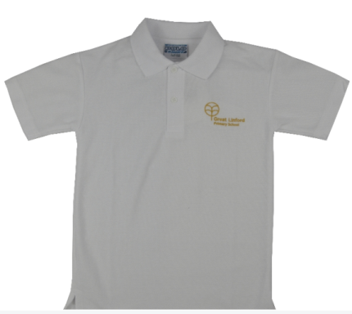
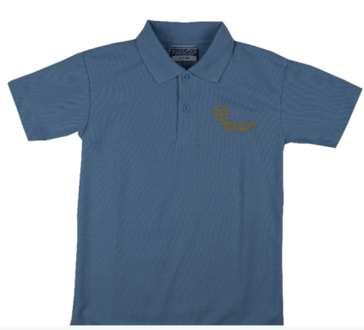
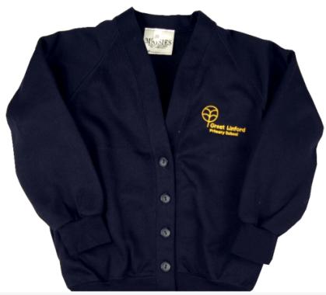
Uniform
Black/Grey trousers/skirt.
Black shoes
White or blue shirt/polo
Navy blue cardigan/jumper
No bracelets/necklaces/rings
Earrings must be studs, not hooped.
Respect all Overcome challenges Open our minds Take care Speak kindly
Notes:
DM

Slide 16
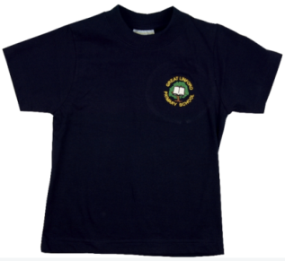
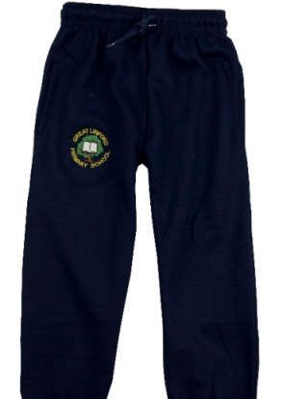
PE Uniform
Navy blue or black trousers/shorts
Blue or white plain t-shirt (or GL logo)
Trainers suitable for outdoor wear
Long hair tied up.
Earrings covered up/removed.
Children must wear their PE kit on PE days (rather than changing in school).
Swimming is on a Wednesday
Respect all Overcome challenges Open our minds Take care Speak kindly
Notes:
DM

Slide 17
Maths fluency facts, TTRockstars and Doodlemaths
Maths fluency facts (like times tables or number bonds) that your child should know ‘by heart’.
Fluency facts should be practised daily at home.
These will be shared each half term on the website and tested weekly (in a similar way to spellings)
Practise your maths facts by playing games, making posters and testing your child.
Children will be given a TT Rockstars and a Doodlemaths log in. This is a good way to practise times tables and other maths skills at home. Aim for 10 minutes a day, every day.
Respect all Overcome challenges Open our minds Take care Speak kindly
Notes:
SS

Slide 18
Spellings
The spellings for each half term will be shared on the website.
You will also be given a log in for Spelling Frame
On Spelling Frame, you can play games and practise tests using the spellings you have been given on Google Classroom.
Spellings should be practised at home daily.
Spellings from previous weeks should also continue to be practised so that the spellings become part of childrens’ long term memory rather than being forgotten within a few weeks.
Respect all Overcome challenges Open our minds Take care Speak kindly
Notes:
SS

Slide 19
Expectations – Year 4 Maths
Working with numbers that have up to 4 or 5 digits.
Developing fluency with our written methods.
All times tables and addition facts should be fluent.
Beginning to use numbers with up to 2 decimal places.
Using fractions and decimals to solve problems.
Should be fluent in telling the time.
Times tables are a key priority in year 4 and should be practised daily.
Thrive Enjoy Achieve Aspire

Slide 20
Year 4 MTC (Multiplication Tables Check)
At the end of year 4, all children take part in a times table check.
It is a statutory requirement for all schools to carry out this check as of 2021.
The test consists of 25 times table questions.
Children will have 6 seconds per question.
The checks are carried out on a computer.
The ‘soundcheck’ game on TT Rockstars mimicks the DfE version of the check.
Thrive Enjoy Achieve Aspire

Slide 21
Expectations - Writing
Use of cursive handwriting and accurate use of capital letters, full stops and commas.
High frequency spellings including those with suffixes and prefixes should be mostly accurate.
Should be able to plan their writing and choose appropriate vocabulary, using a thesaurus when needed.
Should be able to check their writing for grammatical errors.
Writing in clear organised paragraphs.
Using different sentence structures and different ways to start a sentence.
Thrive Enjoy Achieve Aspire

Slide 22
Expectations - Reading
Read for enjoyment a range of text types.
Understand how information books can be organised.
Begin to make inferences about characters and their motives.
Begin to summarise larger parts of a text.
At home, children should be reading for 15 minutes every day. An adult should sign their reading record to say that they have read. Ideally, this should be aloud to someone else.
Thrive Enjoy Achieve Aspire

Slide 23
Autumn Term 1
Europe
We will be reading ‘Boy Giant’.
We will be focusing on the human and physical geography of European countries.
We will learn about seas, mountain ranges and rivers in Europe.
Thrive Enjoy Achieve Aspire

Slide 24
Autumn Term 2
Romans
We will be reading ‘Over the Roman Wall’
We will be studying the Roman Empire and the impact it had upon Britain and other parts of Europe.
Thrive Enjoy Achieve Aspire

Slide 25
Spring Term 1
Anglo-Saxons
We will be reading ‘Beowulf’
We will be learning about the Anglo-Saxons and their ways of life.
Thrive Enjoy Achieve Aspire

Slide 26
Spring Term 2
Rainforests
We will be reading ‘The Explorer’.
We will be finding out about the rainforest biome and why it must be protected.
Thrive Enjoy Achieve Aspire

Slide 27
Summer Term 1
Vikings
We will be reading ‘Viking boy’.
We will be finding out about how the Vikings lived and why they came to Britain.
Thrive Enjoy Achieve Aspire

Slide 28
Summer Term 2
A Local Study: Canals
We will be finding out about canals in our local area.
We will be finding out about why the canals were built and how their purpose has changed over time.
Thrive Enjoy Achieve Aspire

Slide 29
Your child’s progress
Parent’s evening will take place during the Autumn term and again in Spring.
Further information about these appointments will follow in the Autumn term.
Thrive Enjoy Achieve Aspire

