Slide 1
Welcome to Year 1!
Mrs Laura Dudley – Cedar Class Teacher and Year Group Lead
Mrs Melissa Collins – Rowan Class Teacher
Sandy Eaglen – Learning Support Assistant
Roz Smith - Learning Support Assistant
Codie Pearson - Learning Support Assistant
Thrive Enjoy Achieve Aspire

Slide 2
Key Adults in our school
Miss Lovelock – Headteacher
Mr Jenkins – Deputy Headteacher
Mrs Woolley - SENCO
Carol Mallett – Family champion
Thrive Enjoy Achieve Aspire

Slide 3
Thrive
Achieve
Aspire
Enjoy
Respect all Overcome challenges Open our minds Take care Speak kindly
Notes:
This image shows our tree. We have one of these trees as a display in each classroom and it forms the basis of our behaviour management system. Each child has a leaf and at the start of each session this will be on green. As children follow our roots and values, they are showing they are part of our family and part of our tree. Children who go ‘above and beyond’ will have their leaf moved to a gold bird. This earns them house points. If children are not following our roots and values, their leaf may be moved to the yellow or the red leaf until they begin to make the right choices again.

Slide 4
Our ROOTS
Respect all people, animals and the environment.
Overcome challenges and never give up.
Open our minds to creativity and curiosity.
Take care of our bodies and our minds.
Speak kindly and listen to others.
Respect all Overcome challenges Open our minds Take care Speak kindly
Notes:
These are our roots, which all children are expected to follow in our school.

Slide 5
Yellow and Red Leaves
Warning.
Not following our ROOTS.
3 yellow leaves in 1 day = red leaf.
Still not making the right choices.
Consequence and reflection.
3 red leaves in one week, or a more serious incident = lunchtime detention
Respect all Overcome challenges Open our minds Take care Speak kindly
Notes:
If children are not following our roots, they are given a verbal warning. If their behaviour continues, their leaf will be moved to yellow until they are able to follow the roots again. If a child goes down to yellow 3 times during the same day, this results in one red leaf. A red leaf may also not be given if behaviour is not improved after moving to yellow, or for serious incidents. A red leaf results in a consequence, such as some of their break being missed. Three red leaves in one week results in a lunchtime detention.

Slide 6
Rewards
Aspire trophy
House points
Certificates
Respect all Overcome challenges Open our minds Take care Speak kindly
Notes:
Each week, one child who has gone ‘above and beyond’ by putting a lot of effort into their learning, will be awarded the aspire trophy. This will sit on their desk for the week and they will receive 3 house points. We also award gold leaves each week for demonstrating our roots. House points are also awarded.

Slide 7
House System
Every child is either yellow, blue or green house.
Houses should match their siblings houses.
The children who follow our roots will be awarded house points. These are then totalled at the end of each term with a prize for the winning house.
Thrive Enjoy Achieve Aspire
Notes:
Children stay in the same house throughout their time at our school. This should be the same house as siblings in the school.

Slide 8
Communication
School Gateway – ensure you are registered.
Our website – www.greatlinfordprimaryschool.co.uk
Home reading journal – checked daily
Google classroom - 5lb5xex
Call the office to make an appointment.
Family Champion-Carol
Thrive Enjoy Achieve Aspire

Slide 9
Google Classroom
You will be sent your new google classroom code to access any home learning. 5lb5xex
On Google classroom you will find:
Links to websites we have subscriptions for
Key vocabulary to practise at home
Weekly spellings
Maths facts to practise at home
Important messages relevant to our year group
Thrive Enjoy Achieve Aspire

Slide 10
Pupil Premium
Funding is given to schools for each child registered for pupil premium.
This funding enables us to support these pupils in any way necessary to improve their education.
This may include discounts for school trips, uniform and after-school clubs.
If you think you may be eligible to register your child as pupil premium, please speak to Carol Mallett (our family champion) or the office.
Further information about how to apply and how this funding is used at our school is on the website.
Thrive Enjoy Achieve Aspire

Slide 11
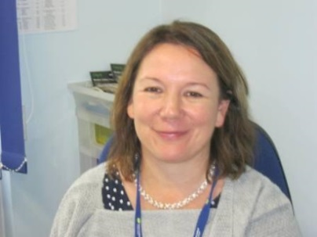
Our Protective Hands
Each child has a protective hand. It lists 5 people they can go to if they are feeling sad or worried.
Each class also has a worry box – this is checked daily.
Our designated safeguarding lead is our head teacher – Miss Lovelock.
Thrive Enjoy Achieve Aspire

Slide 12
What to do if you think your child is being bullied:
Encourage them to speak to an adult in school through use of their protective hand, the worry box in their class or by speaking directly to their teacher.
Make an appointment through the office with your class teacher to voice your concerns. All worries will be taken seriously and investigated.
Thrive Enjoy Achieve Aspire

Slide 13
Our expectations
Good attendance – 100%
Correct uniform and PE kits.
Come to school prepared – water bottle and healthy snack
Reading journals in school every day
Read at home 5 times a week – journal signed by adults.
Practise spellings and KIRFs (maths fluency facts) at home daily.
Thrive Enjoy Achieve Aspire

Slide 14
Home Learning
Each half term, we will share our home learning activity sheet. Home Learning is split into 3 main categories: arts, STEM (Science Technology Engineering and mathematics) and music. Children can choose to complete one or many of the suggested activities.
When is the Home Learning sheet shared? The first week of each half term.
When is it due in? 2 weeks before the end of half term. The first term’s entries are due in Monday 10th October 2022.
How is work shared? All entries are shared in class and an overall winner is chosen. Winners will be celebrated in the last week of half term.
Entries can be submitted remotely or handed in.
Thrive Enjoy Achieve Aspire

Slide 15
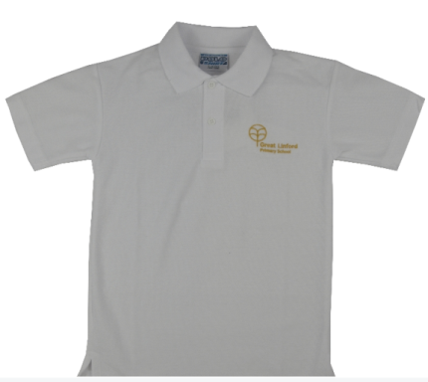
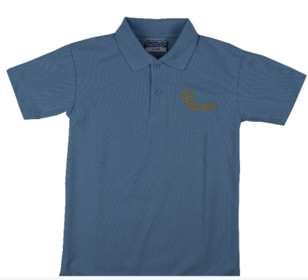
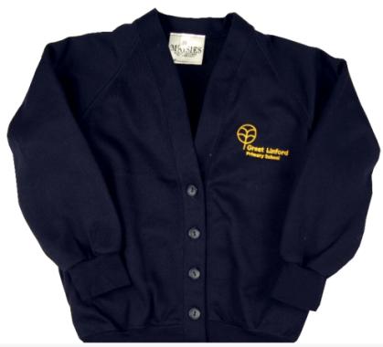
Uniform
Black/Grey trousers/skirt.
Smart black shoes (no trainers)
White or blue shirt/polo
Navy blue cardigan/jumper
No bracelets/necklaces
Earrings must be studs, not hooped.
Respect all Overcome challenges Open our minds Take care Speak kindly
Notes:
DM

Slide 16
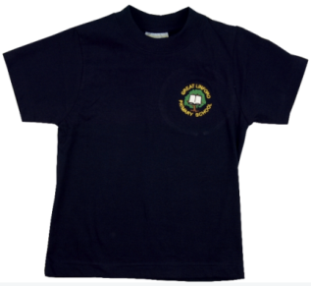
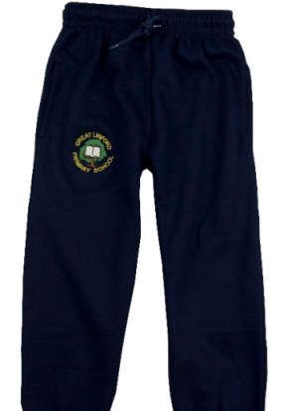
PE Uniform
Navy blue or black trousers/shorts
Blue or white plain t-shirt (or GL logo)
Trainers suitable for outdoor wear
Long hair tied up.
Earrings covered up/removed.
Children must wear their PE kit on PE days (rather than changing in school).
Respect all Overcome challenges Open our minds Take care Speak kindly
Notes:
DM

Slide 17
Maths fluency facts, TTRockstars and Numbots
Maths fluency facts (like times tables or number bonds that your child your should know ‘by heart’).
These will be shared each half term on Google classroom and tested weekly (in a similar way to spellings).
Practise your maths facts by playing games, making posters and testing your child.
Children will be given a TT Rockstars/ Numbots log in. This is a good way to practise times tables and other maths skills at home. Aim for 10 minutes a day, every day.
Respect all Overcome challenges Open our minds Take care Speak kindly
Notes:
SS

Slide 18
Spellings
Weekly spellings will be shared on Google classroom.
You will also be given a log in for Spelling Frame
On Spelling Frame, you can play games and practise tests using the spellings you have been given on Google Classroom.
Spellings should be practised at home daily.
Spellings from previous weeks should also continue to be practised so that the spellings become part of children's long term memory rather than being forgotten within a few weeks.
Respect all Overcome challenges Open our minds Take care Speak kindly
Notes:
SS

Slide 19
Expectations - Maths
Count to and across 100 forwards or backwards.
Count in multiples of 2, 5 and 10.
Begin to recall addition and subtraction facts to 20.
Know the place value of each digit in any number up to 100.
Recognise o’clock and half past on an analogue clock.
Thrive Enjoy Achieve Aspire

Slide 20
Expectations - Writing
Write simple narratives about personal experiences and those of others
Demarcate most sentences in their writing with capital letters and full stops
Question mark used with some accuracy
Use coordinating conjunction ‘and’
Form capital letters mostly correctly
Spell some common exception words on the Y1 list
Use spacing between words
Thrive Enjoy Achieve Aspire

Slide 21
Expectations - Reading
Read aloud – and re read for fluency – books, poems, stories and nonfiction texts that are consistent with your developing phonic knowledge.
Apply phonic knowledge and skills as the key route to decode words, including those of more than one syllable.
Use sounding and blending techniques to attempt previously unseen words.
Be familiar with, and be able to retell, key fairy tales and traditional rhymes or stories.
Explain clearly your understanding of what is read to you: the significance of the title, key events in the text, vocabulary and predictions of what may happen next.
Thrive Enjoy Achieve Aspire

Slide 22
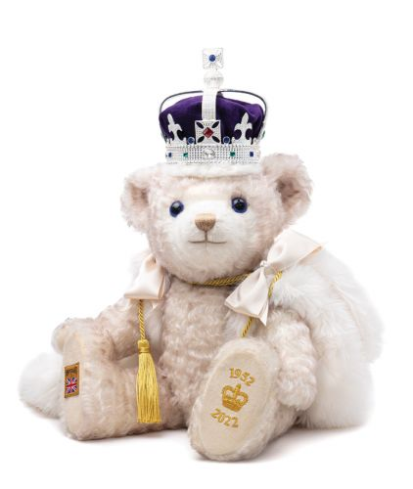
Autumn Term
Our topic: The Adventures of Bear and Queen
We will be learning…
The countries within the United Kingdom
Key facts and history around Queen Elizabeth ||
About historic events in our lives
Thrive Enjoy Achieve Aspire

Slide 23
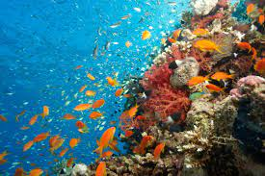
Spring Term 1
Our topic: Under The Sea
We will be learning…
How to use a map to identify the sea around the United Kingdom
How to use a map to identify the 5 oceans
How to make observations from pictures and videos of costal features
Thrive Enjoy Achieve Aspire

Slide 24
Spring Term 2
Our topic: Sustainability
We will be learning…
How to look after our environment
Different types of energy
Looking at different types of weather in our environment
Thrive Enjoy Achieve Aspire

Slide 25
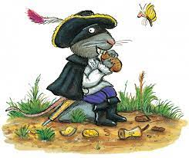
Summer Term 1
Our Topic: The Highway Rat
We will be learning…
All about past transport
Who was the famous highway man, Dick Turpin.
About the story written by Julia Donaldson.
Thrive Enjoy Achieve Aspire

Slide 26
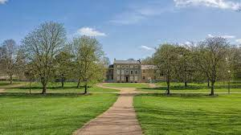
Summer Term 2
Our topic: A Local Study
We will be learning…
About our local area.
The history of Great Linford.
The geography surrounding us.
Thrive Enjoy Achieve Aspire

Slide 27
Statutory Testing
Phonics screening check
-The Phonics Screening Check is a test for children in Year 1. Children take it during June in a one-to-one setting with a teacher.
-More information will be sent out to parents over the year.
Thrive Enjoy Achieve Aspire

Slide 28
Your child’s progress
Parent’s evening will take place during the Autumn term.
Further information about these appointments will follow.
Written report on their progress will be given in Summer 2.
Thrive Enjoy Achieve Aspire

