Slide 1
Cake and Curriculum
The purpose of these is to inform our parents of what to expect and also what expectations we have of them! We are working in partnership together for the benefit of the children.
Respect all Overcome challenges Open our minds Take care Speak kindly

Slide 2
The Year 1 Team
Mr Shipton (Year 1 leader) Rowan Class
Miss Scoggins -Cedar Class
Miss Flynn- Cedar Class
Vicki Chaulk– Learning support assistant
Melina Szkopik – Learning support assistant
Tom Rowlands- Assistant Head teacher for EYFS and KS1

Slide 3
Our ROOTS and Values
See the tree!

Slide 4
Our Roots
Respect all people, animals and the environment.
Overcome challenges and never give up.
Open our minds to creativity and curiosity.
Take care of our bodies and our minds.
Speak kindly and listen to others.
We expect everyone in our Great Linford Family to follow these values.

Slide 5
Red and Yellow leaves
Warning.
Not following our ROOTS.
3 yellow leaves in 1 day = red leaf.
Still not making the right choices.
Consequence and reflection.
3 red leaves in one week, or a more serious incident = lunchtime detention
Serious incidents will involve a phone call home to parents

Slide 6
Rewards
Aspire trophy
Gold ‘above and beyond’ stickers
Gold leaves
House points

Slide 7
House point System
Each child has been allocated a house to be part of and that will be their house throughout their time at school.
We will use the house system for rewards and sports day. Children will be awarded points which are added up weekly. Each term the winning house will receive a prize!

Slide 8
Our Expectations in Year 1
Our expected level of attendance is 97%-
Every child should wear our school uniform-no jewellery or nail varnish, please!
Come to school prepared-coats in the winter and on rainy days, PE kit, Forest School kit, Book bag with reading book.
4 . Listen to your child read every day
5. Children in school on time. Drop off and pick up from the class room door

Slide 9
How to communicate with us
School Gateway-ensure you are registered, the office can help you with this.
Home reading journal- any messages will be picked up daily. However…
If you need to speak to us more urgently please make an appointment at the office.
You can keep up to date with us school website

Slide 10
Pupil Premium
Funding is given to schools for each child registered for pupil premium.
This funding enables us to support these pupils in any way necessary to improve their education.
This may include discounts for school trips, uniform and after-school clubs.
If you think you may be eligible to register your child as pupil premium, please speak to Carol Mallett (our family champion) or the office.
Further information about how to apply and how this funding is used at our school is on the website.

Slide 11
What to do if you think your child is being bullied
Encourage your child to speak to their teacher or a person on their protective hand
If you are still concerned, make an appointment with your child's class teacher to voice your worries
ALL worries will be taken seriously and investigated.

Slide 12
What do to if you have a worry or concern
Speak to your class teacher
Speak to the Year lead - Sam Shipton
Speak to the Assistant Head - Tom Rowlands
Speak to the Deputy Head – Alex Kerrigan
Speak to the Head teacher – Tara Lovelock

Slide 13
Protective Hands –Keeping your child safe !
To support keeping your child safe, they create their own protective hand .
On this hand they write five people they can go to if they are worried or scared. They will include someone at home and people within the Great Linford school family.
If children wish to speak in confidence, they can place a peg with their name on the worry line which the class teacher or TA will check daily and then ensure they speak to the child .

Slide 14
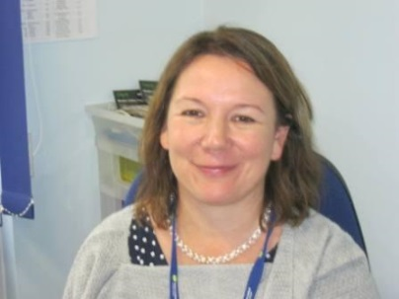
Safeguarding
Our designated Safeguarding lead is Miss Lovelock.
If you have any concerns about safeguarding then please see your child’s class teacher who will pass information on to Miss Lovelock if appropriate/necessary.

Slide 15
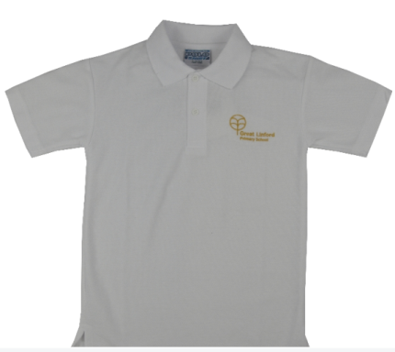
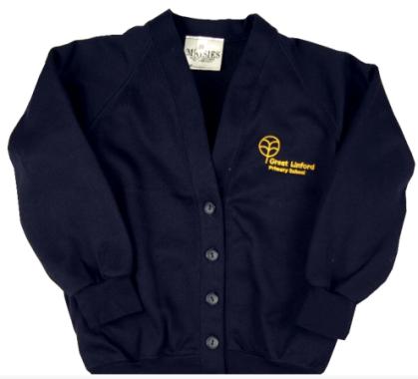
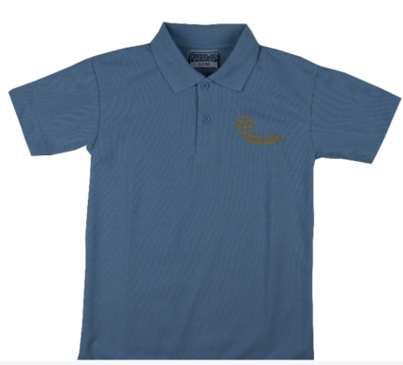
Our school uniform
To create a sense of belonging and family we expect your child to proudly wear the Great Linford School uniform.
•Grey, black or navy trousers, skirt or tailored shorts (no tracksuit bottoms).
•Girls can wear blue and white gingham or striped summer dresses .
•Blue or white polo shirt, shirt or blouse, plain or with school logo.
•Navy sweatshirt or cardigan, plain or with the school logo (no hooded tops).
•Navy or grey tights – no multi-colours .
•Navy, grey or white socks – no multi-colours.
•Black flat sensible safe shoes – no high heels and no trainers

Slide 16
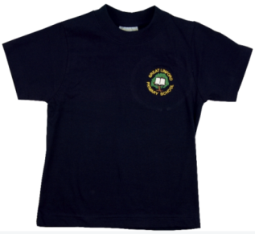
PE Kit
Please ensure your child has their kit in school at the beginning of the week.
A change of clothes and footwear is needed for PE and games.
This should consist of: navy blue T-shirt, navy blue shorts, plimsolls or training shoes for Games. Navy blue sweat shirts and jogging bottoms can be worn for outside PE in cold weather

Slide 17
Forest Schools
Wellies or old trainers
Long sleeves/trouser legs (in all weathers )
Warm, waterproof clothes
Old clothes that you don’t mind getting a little muddy or wet!

Slide 18
How year 1 works
This half term children who have not met Foundation expectations and who need more support will work daily with Sandy. This will prepare them for joining the rest of the class mid October .
Other children will work with their class teachers
Each day the children will have lessons in Maths, English ,Guided Reading and Handwriting.
They will work in small ability groups.

Slide 19
End of Year 1 expectations Reading
Read aloud – and re read for fluency – books, poems, stories and nonfiction texts that are consistent with your developing phonic knowledge.
Apply phonic knowledge and skills as the key route to decode words, including those of more than one syllable.
Use sounding and blending techniques to attempt previously unseen words.
Be familiar with, and be able to retell, key fairy tales and traditional rhymes or stories.
Explain clearly your understanding of what is read to you: the significance of the title, key events in the text, vocabulary and predictions of what may happen next.

Slide 20
Writing
With increasing accuracy, form lower case letters and the digits 0 -9 in the correct direction.
Read aloud your writing so that peers and teachers can understand the meaning.
Use capital letters for names, places, the days of the week and the personal pronoun ‘I’.

Slide 21
Maths
Count to and across 100 forwards or backwards.
Count in multiples of 2, 5 and 10.
Begin to recall addition and subtraction facts to 20.
Know the place value of each digit in any number up to 100.
Recognise o’clock and half past on an analogue clock.

Slide 22
Projects for the Year
Autumn 1- Let’s Celebrate!
Autumn 2- Through the Window
Spring 1-The Highway Rat
Spring 2-How Does Your Garden Grow?
Summer 1-Under the Sea
Summer 2- Chocolate!

Slide 23
Trips and Visitors
To support our learning we will be involved in various ignite activities.
Autumn 1 in house ignite
Autumn 2 – Walk around our local area
Spring 1-Visit to Milton Keynes Museum
Spring 2 – in House ignite
Summer 1- A visitor from the RNLI team will come and visit our children
Summer 2 – In house ignite

Slide 24
Home Learning
Daily-Reading
Termly- Home Learning Challenges
Children to share their learning within the class and receive verbal feedback from both class teacher and peers. All those who take part receive a certificate and the winner shares their work in assembly.
KIRFS- Focus on maths skills, once secure with first skill on KIRF 1 move to KIRF 2 and so on.

Slide 25
Keeping you informed of your child’s progress
We are a team!
There will be parent’s evening in the Autumn and Spring terms
A written report about your child’s progress will be given to you at the end of the Summer Term

