Slide 1
Facts about Mars and Jupiter
By Princess and Ella

Slide 2
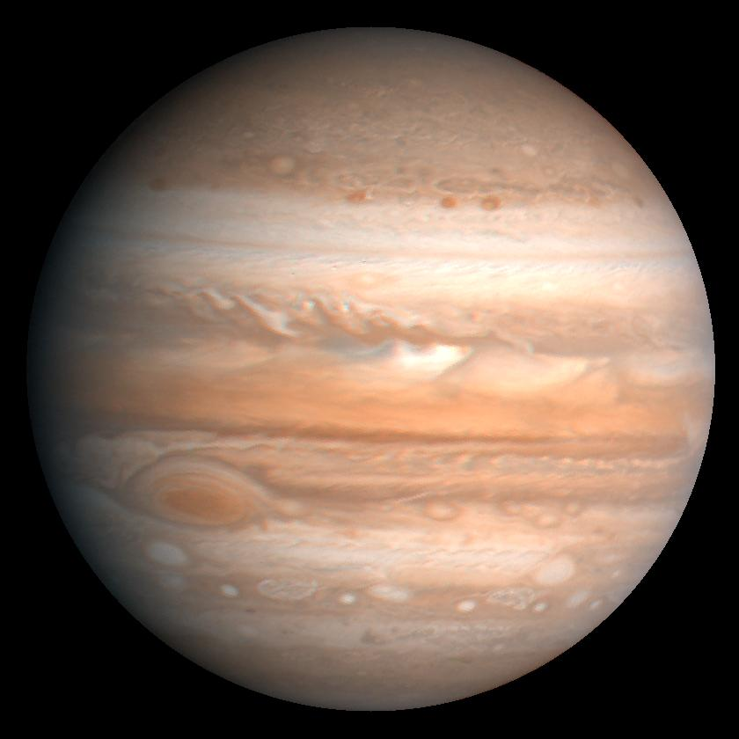
What is Jupiter
Jupiter is the fifth planet in the solar system and it is made out of gas which means it is known as a gas giant. It is also characterised by its colossal, red dot.

Slide 3
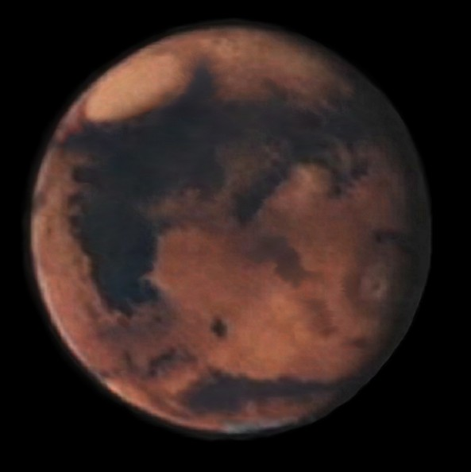
What is Mars?
Mars is the fourth planet in the solar system and it is a rocky planet. Mars is famously known as the red planet because of how red it is.

Slide 4

What is the weather in Jupiter
The weather in Jupiter is minus 234 degrees fahrenheit. The big red dot on Jupiter is actually a giant hurricane - like storm.

