Slide 1
Year 4 MTC meeting
29th November 2022
Thrive Enjoy Achieve Aspire

Slide 2
What is the MTC?
The MTC is the Multiplication Tables Check and is used to see whether your child can fluently recall their times tables up to 12 x 12. It takes place at the start of June over a 3 week period.
It is an on screen check with 25 questions and 3 practice question. Each question has a time limit of 6 seconds, so the overall check should take no longer than 5 minutes.
Thrive Enjoy Achieve Aspire

Slide 3
What is the purpose of the MTC?
Its purpose is to ensure that all children are fluent in their times tables before they start year 5. This is because in year 5 they will be required to use their times tables regularly to solve more complex problems such as:
Equivalent fractions
Long multiplication
Decimal calculations
In the National Curriculum, children are expected to know their times tables but until 2021, there was no formal testing in this.
Thrive Enjoy Achieve Aspire

Slide 4
Cognitive Load
Children who know their times tables fluently are better able to solve more complex problems such as word problems.
This is because the cognitive load is lower, as they are not relying on their working memory to work out times tables as well as working out what else the question is asking them to do.
Thrive Enjoy Achieve Aspire

Slide 5
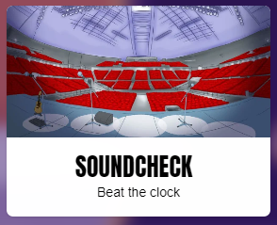
Do I need to do anything to prepare my child?
We are asking children to practice each day on Times Tables Rock Stars. There is a mode on the site called Soundcheck; this mode is a replica of the MTC that your child will be sitting in June. Each week, maths fluency facts are sent home which are also to help prepare for the MTC. Please practice them with your child.
Thrive Enjoy Achieve Aspire

Slide 6
How will the results be used?
The results will be given to the school after the testing period in June. They will then be shared with children and parents after this time.
The results will be used to show where children need more support and help inform future planning.
Thrive Enjoy Achieve Aspire

Slide 7
What if my child cannot access the check?
There are several access arrangements that are available for the check and can be used to support pupils with their needs. These arrangements will be put in place during practice checks before the test in June.
The check has been designed to be as inclusive and accessible as possible. However, there still may be circumstances where it will not be appropriate for a pupil to take the check.
Thrive Enjoy Achieve Aspire

Slide 8
Any questions?
Thrive Enjoy Achieve Aspire

