Slide 1
KS2 Maths Puzzle morning
Miss Scott – maths lead and year 4 teacher
Respect all Overcome challenges Open our minds Take care Speak kindly

Slide 2
Maths Anxiety
Feelings of anxiety when faced with maths problems
Not wanting to engage in maths
Avoidance of maths for fear of failure
Respect all Overcome challenges Open our minds Take care Speak kindly

Slide 3
How can we avoid it?
Don’t say ‘I hate maths’ or ‘I’m terrible at maths!’
Admit that maths is hard, and that it’s okay to find things hard sometimes.
Talk about why learning something new is difficult.
Let them know it’s okay to get something wrong.
Respect all Overcome challenges Open our minds Take care Speak kindly

Slide 4
Growth Mindset
Teaching children the skills they need to succeed.
Making children aware that our abilities are not fixed – with hard work we can improve at anything.
Preparing children for the feelings they may experience when faced with something difficult.
Respect all Overcome challenges Open our minds Take care Speak kindly

Slide 5
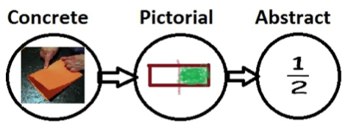
Making Maths Fun!
Use puzzles and games to spark their imagination.
Use objects to help like cubes or counters.
Make it into a game.
Respect all Overcome challenges Open our minds Take care Speak kindly

Slide 6
Useful Resources
https://www.greatlinfordprimaryschool.co.uk/maths.html
https://nrich.maths.org/primary
https://wild.maths.org/
Respect all Overcome challenges Open our minds Take care Speak kindly

