Slide 1
Mercury
AuroraM and HannahM and AliP

Slide 2
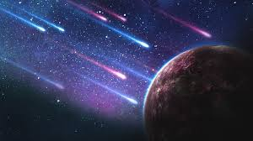
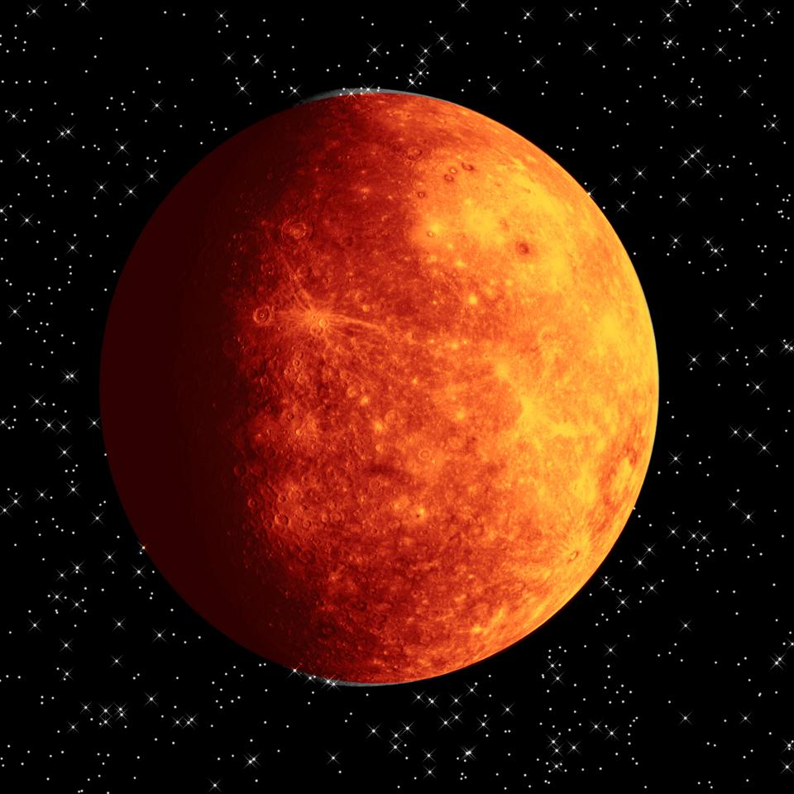
Where in the universe
Mercury is the closest planet to The Sun and because it is so close when it spins it gets extremely hot.Because it spins so slowly, when it’s facing away from The Sun it develops ice.It is blazing with orange flames.

Slide 3
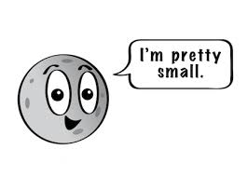
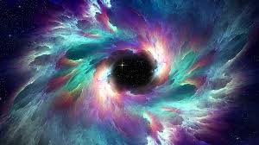
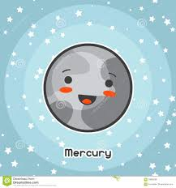
Weather on Mercury
The weather on Mercury can be fatal.At daytime, the weather can reach up to 801 °c.However , in the night it can get very cold.If you went on Mercury you would burn to death!!!!!!!!!!!!!!

Slide 4
Does it have moons or rings?
No.It does not have any moons or rings because its gravitational pull is too weak as it is so small.

