Slide 1
English and writing
Writing at Great Linford Primary School
Early Years and Key Stage 1

Slide 2
Our Vision
We believe that all children should have the right to communicate effectively with the wider world.
That the curriculum should be broad and balanced and reflect the world in which we live.
That children should be exposed to a wide range of writing genres and texts.
That all children should enjoy their lessons.

Slide 3
The Curriculum
Phonics is taught using the ‘Read, Write, Inc’ scheme.
Writing is taught using the Talk for Writing process. This involves engaging with a text, learning key features of a genre and allowing the children to create their own narratives.
Grammar is embedded from EYFS and children are equipped with the terminology needed for KS2 and beyond.

Slide 4
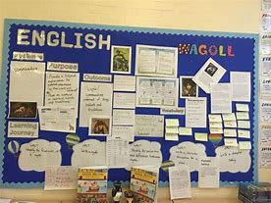
So what is Talk for Writing?
Talk for Writing, developed by Pie Corbett, is powerful because it is based on the principles of how children learn.
It allows children a chance to imitate the language they need for a particular topic orally before creating their own examples.
The method:
1. Imitate
2. Innovate
3. Independent Application

Slide 5
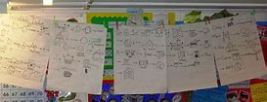
What might you see?
Children engaged and ready to learn.
All children involved and speaking with confident voices.
Talking the text
Shared writing
Examples of work on the Learning Journeys.
Text maps
Drama

