Slide 3
Great Linford Primary School
June 23-24 2022

Slide 5
Accommodation arrangements.
Boys and girls will be in separate yurts.
All of the boys will be in Colossus yurts and the girls will be in Enigma yurt.
There are bunk beds and beds for children who may need additional support at night time. Staff will also sleep in the yurts in their own rooms or on the sofa beds in the open area.

Slide 12
Food
Meals are included except for day 1 lunch. If you are free school meals we can arrange this as usual, but it will be a packed lunch.
Please supply a fully disposable packed lunch for the first day.
Dinner in the evening – Thursday night is BBQ night.
all dietary needs are catered for including allergies, intolerances, religious requirements, accommodating special diets.
Hot chocolate and biscuits for the evening – possibly around a campfire.
Breakfast – toast with butter and jams, cereals – plenty of choice, milk and yoghurts.
Lunch on departure day – filled sandwiches, crisps, biscuit bar, fruit and squash.
Drinks and biscuits are available as well as tea and coffee for the staff.

Slide 17
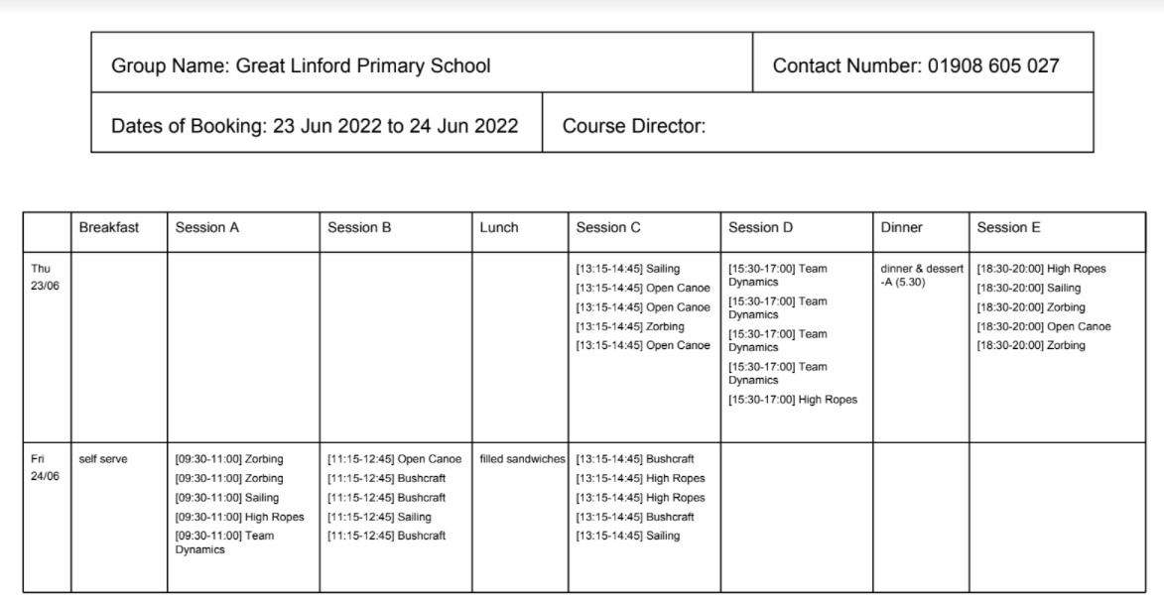

Slide 18
Staff going…
This is yet to be fully confirmed, but will include Miss DJ, Mrs Smith and hopefully all of the year 3 team members.

