Slide 1
Welcome to Foundation at Great Linford Primary School
Aspire, Achieve, Enjoy, Thrive

Slide 2
Great Linford Early Years Vision
We believe that every child is unique and has a right to a challenging, creative and inspiring curriculum which will harness and build on the hundred languages of children. They will be immersed in a nurturing, caring and safe environment with families, teachers and other children as co-learners. They will be given the roots to achieve to their true potential in every aspect of learning not only for their journey through Great Linford but to enable them to thrive as a lifelong learner.
We believe that building respect, responsibility and community between children, families and staff are at the core of enabling every child to become an active constructor of knowledge both inside and outside of the classroom.

Slide 3
Welcome Pack
Name of the class your child is in.
Name of your child’s class teacher.
Your home visit date and time.
Your child’s start date and time.
Term dates
Uniform information
GDPR agreement
Information on hot dinners
Information on pupil premium

Slide 4
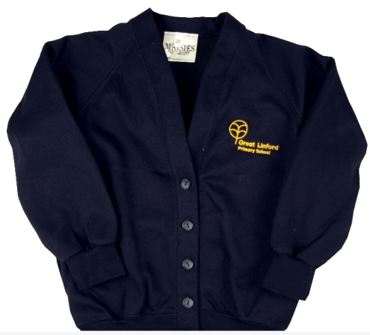
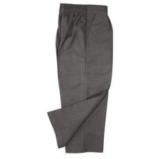
School Uniform

Slide 5
PE Kit

Slide 6
What your child will need when they start school
School uniform and PE kit.
Please provide a spare set of clothes they can keep on their peg in case of accidents.
They will take part in forest schools each week so waterproofs and wellies would be really useful.
Please ensure your child has some form of book bag.
Name everything!

Slide 7
How to prepare you child
Encourage them to dress themselves each morning.
Encourage them to practise putting on their own shoes.
Encourage them to start doing up their own coats.

Slide 8
Attendance
We aim for 97%
Certificates given out at the end of each term to celebrate good attendance.
No holidays in term time – law
Sickness and/or diarrhoea – 48 hour policy. We aim to combat this by lots of washing of hands!

Slide 9
Pupil Premium
If you are in receipt of any the following benefits then you may be eligible for pupil premium:
Income support
income-based Jobseekers Allowance
income-related Employment and Support Allowance
support under part VI of the Immigration and Asylum Act 1999
the guaranteed element of State Pension Credit
Child Tax Credit (provided you are not also entitled to Working Tax Credit and have an annual gross income of no more than £16,190)
Working Tax Credit run-on, which is paid for four weeks after you stop qualifying for Working Tax Credit
Universal Credit
Why apply?
If you apply and qualify for pupil premium then your child will receive free school meals, half price uniform as well as only paying half price for any trips your child will go on.
How to apply?
Register at https://emsonline.milton-keynes.gov.uk/CitizenPortal_LIVE

Slide 10
Dates to remember
Monday 2nd July – 10am – 11am.Stay and Play -with Parents/carers
Wednesday 11th July – 2pm-3pm. Stay and Play-without parents/carers (parents please stay in our community room)
Wednesday 18th July – 2pm – 3pm.Gruffalo picnic and outdoor art –With Parents/Carers

Slide 11
Any Questions?

