Slide 1
Spelling Curriculum Update 2019

Slide 2
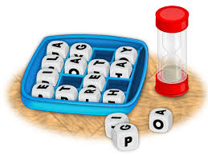
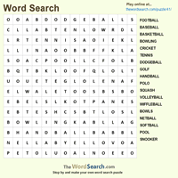
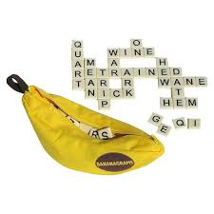
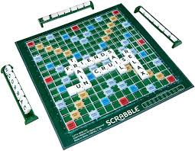
Animal | Island | Food | Verb

Slide 3
Why are changes happening?
Old | New
Too many to learn To much to do at home Only once per week Those who struggled gave up | Engagement of SEND Is daily allowing for constant revision Bridges the gap between KS1 and KS2 Bridges gap between phonics and Y2 IS FUN!

Slide 4
What is ‘No Nonsense’ spelling?
NNS is a spelling scheme different to other schemes.
It is research based, embracing knowledge of spelling conventions (patterns and rules)
It’s clear, manageable and progressive

Slide 5
The theory:

Slide 6
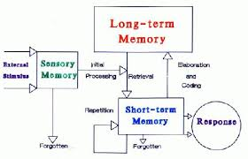
The theory:

Slide 7
How is it organised?
Programme consists of:
Daily lessons and revision
Home tasks that are all optional
Tested weekly
No more than 5 (based upon research)

Slide 8
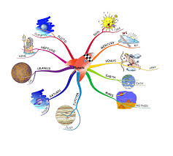
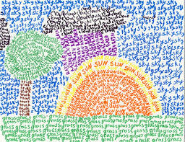
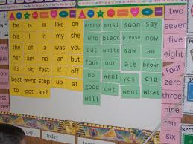
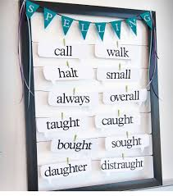
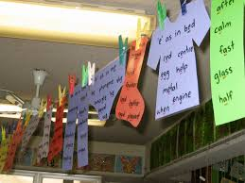
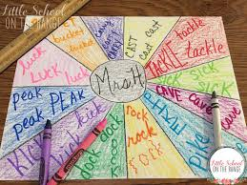
Use of a spelling journal
Be creative – support work at home and at school.

Slide 9
And finally…
Check the website (phonics and spelling tab)
Take part in the spelling bee
Give us feedback (later in the year)
Come for a chat

