Slide 1
UKS2 Maths Workshop
Steph Scott – Maths Leader and Year 4 Teacher

Slide 2
Connective Model
Symbols
Vocabulary
Pictures
Apparatus

Slide 3
Number and place value
Need to be able to work with large numbers.
Tens of thousands.
Working comfortably with 5 and 6 digit numbers
Able to read 7 digit numbers and subtract a single digit number from them.

Slide 4
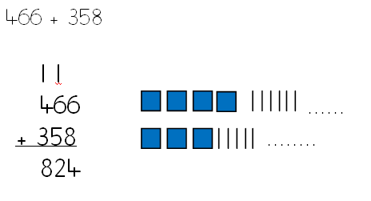
Addition in Years 5 and 6
Learning column addition – formal method

Slide 5
Column addition
Children need to know when it’s appropriate to use a written method.
Children need to be able to add with decimals.

Slide 6
Subtraction in Years 5 and 6
Taking away
Counting back – for when the amount you are taking away is very small. E.g. 227 - 14
Finding the difference
Counting on – for when the amount you are taking away is only slightly smaller than the amount you started with. E.g. 227 - 223

Slide 7
Subtraction in Years 5 and 6
Subtracting using column method
Exchanging – not borrowing.

Slide 8
Subtraction
Children need to know when to subtract mentally and when to use a written method
100,000 - 3

Slide 9
Multiplication in Years 5 and 6
By the start of year 5 – should know all times tables up to 12 x 12.
Addition facts equally as important.

Slide 10
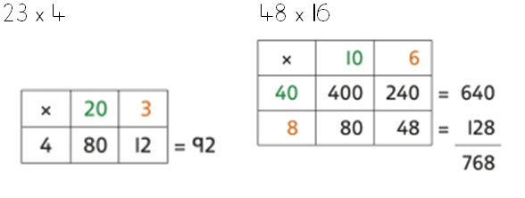
Area method/grid method
The first written method for multiplication

Slide 11
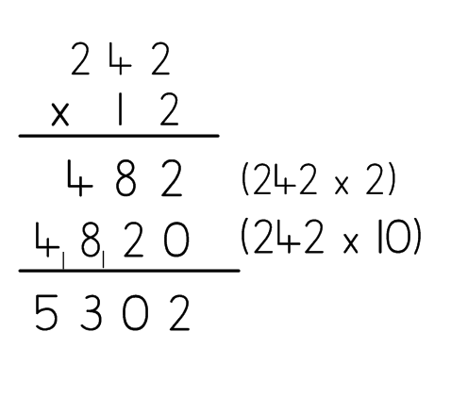
Long multiplication
Also need to be able to
multiply decimals,
and multiply more than 2 numbers.

Slide 12
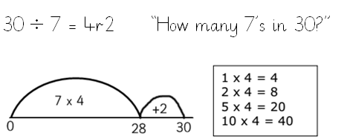
Division in Years 5 and 6
Division on a number line

Slide 13
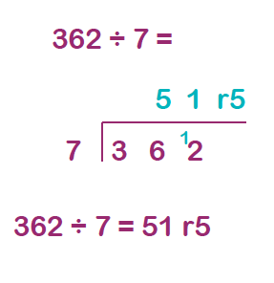
‘Bus stop’ division
By the start of year 5, children are expected to be able to
divide using short division giving exact answers (not remainders)

Slide 14
Multi-symbol questions
5 x 4 x 3 =
7 x 8 + 14 =
13 x 4 – 7 =
234 + 131 > 311 + ___
12 x 4 = __ x 6

Slide 15
Maths number sense and facts
Days in a year/leap year
Days in each month
Conversions of units of measurement (and how to order them)
Prime numbers, factors, multiples
Spotting clever patterns in number sequences
Knowing how to estimate

Slide 16
Fractions
Fractions are taught in lots of different contexts:
Fractions of numbers
Fractions of shapes
Fractions of objects e.g. A length of ribbon
Fractions of sets of objects e.g. Pencils
Fractions of distances
Fractions on a number line
Children need to be able to relate fractions to their equivalent decimals and percentages.

Slide 17
Fractions, decimals, percentages
Need to understand mixed numbers
Adding and subtracting fractions
Simplifying fractions
Multiplying fractions by a whole number
Finding percentages of numbers
Comparing fractions, decimals and percentages

Slide 18
Other areas...
Time – calculate periods of time
Money – are ‘family tickets’ at the cinema worth the money? Are offers fair?
Measurements – comparing and ordering when there are different units involved
Shapes – finding the area or perimeter of a shape.
Circles – labelling the parts of a circle
Reading tables, charts and graphs

Slide 19
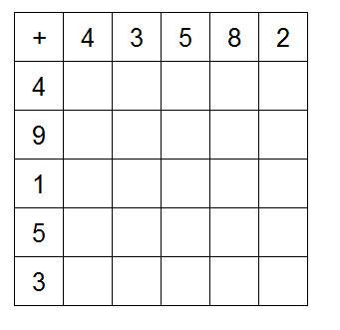
FAST Maths
Every day
3 minutes to complete. Must be errorless

