Slide 1
Writing Open Morning Lower School
The Writing Process at Great Linford Primary School

Slide 2
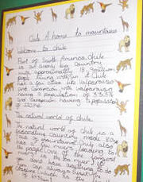
What is Talk for Writing?
Talk for Writing is an engaging teaching framework. It is powerful because it is based on the principles of how children learn. It enables children to imitate the language they need for a particular topic orally, before reading and analysing it, and then writing their own version.

Slide 3
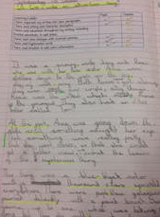
The process:
1. Baseline assessment and planning – the ‘cold’ task
Teaching is focused by initial assessment. Generally, teachers use what is known as a ‘cold’. An interesting and rich starting point provides the stimulus and content but there is no initial teaching. Targets are set and progress can be measured at the end of the unit.

Slide 4
The process:
2. The imitation stage
The teaching begins with some sort of creative ‘hook’ which engages the pupils, often with a sense of enjoyment, audience and purpose. For example, examining fossils (our most recent example) or receiving a letter from a victim in the story, The Highway Rat (year 1) Children are encouraged to explore with ‘short burst writes’.

Slide 5
The process:
3. The innovation stage
Once students are familiar with the model text, then the teacher leads them into creating their own versions. A new subject is presented and the teacher leads students through planning.

Slide 6
The process:
4. Independent application and invention – the ‘hot’ task
Eventually, students move on to the third phase, which is when they apply independently what has been taught and practised. After, children are encouraged to ‘edit’ and produce a final piece. We often add these to their independent writing book.

Slide 7
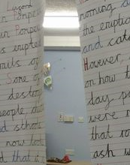
The process:
What to look for when visiting:
Talk the text
Washing lines
Working walls
Grammar starter / language
A shared write led by the teacher

Slide 8
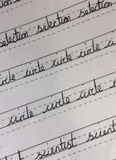
Further support:
Further help and support / resources are available:
Our school website (English page)
Handwriting scheme (Think Write)
Take home resources
Your views are important. Ideas please!

