Slide 1
Welcome to Year One
Miss Funnell (Year lead)- Cedar Class Teacher
Miss Woodward- Rowan Class Teacher
Caroline (LSA)
Sandy (1:1 in Cedar Class)
Thrive Enjoy Achieve Aspire

Slide 2
Thrive
Achieve
Aspire
Enjoy
Respect all Overcome challenges Open our minds Take care Speak kindly
Notes:
This image shows our tree. We have one of these trees as a display in each classroom and it forms the basis of our behaviour management system. Each child has a leaf and at the start of each session this will be on green. As children follow our roots and values, they are showing they are part of our family and part of our tree. Children who go ‘above and beyond’ will have their leaf moved to a gold bird. This earns them house points. If children are not following our roots and values, their leaf may be moved to the yellow or the red leaf until they begin to make the right choices again.

Slide 3
Our ROOTS
Respect all people, animals and the environment.
Overcome challenges and never give up.
Open our minds to creativity and curiosity.
Take care of our bodies and our minds.
Speak kindly and listen to others.
Respect all Overcome challenges Open our minds Take care Speak kindly
Notes:
These are our roots, which all children are expected to follow in our school.

Slide 4
Yellow and Red Leaves
Warning.
Not following our ROOTS.
3 yellow leaves in 1 day = red leaf.
Still not making the right choices.
Consequence and reflection.
3 red leaves in one week, or a more serious incident = lunchtime detention
Respect all Overcome challenges Open our minds Take care Speak kindly
Notes:
If children are not following our roots, they are given a verbal warning. If their behaviour continues, their leaf will be moved to yellow until they are able to follow the roots again. If a child goes down to yellow 3 times during the same day, this results in one red leaf. A red leaf may also not be given if behaviour is not improved after moving to yellow, or for serious incidents. A red leaf results in a consequence, such as some of their break being missed. Three red leaves in one week results in a lunchtime detention.

Slide 5
Rewards
Aspire trophy
Gold leaves
House points
Respect all Overcome challenges Open our minds Take care Speak kindly
Notes:
DM

Slide 6
House System
Every child is either yellow, blue or green house.
Houses should match their siblings houses.
The children who follow our roots will be awarded house points. These are then totalled at the end of each term with a prize for the winning house.
Thrive Enjoy Achieve Aspire
Notes:
Children stay in the same house throughout their time at our school. This should be the same house as siblings in the school.

Slide 7
Communication
Parent Mail – ensure you are registered.
Our website – www.greatlinfordprimaryschool.co.uk
Home reading journal – checked daily. When returning books, children will put these in our classroom quarantine box where they are left for 72 hours before being returned to the shelf.
Call the office to make an appointment. Parents will not be allowed on site without an appointment.
Google Classroom
Julie Newton Work Number- 07591 912054
Carol Mallet Work Number- 07591912028
Thrive Enjoy Achieve Aspire

Slide 8
Google Classroom
You will be sent your new google classroom code to access any home learning.
In the event that your family has to isolate or the class/school is shut, home learning will be shared via this platform.
In an effort to cut down on paper use, the following will now be shared via this platform:
Key Instant Recall Facts for maths
Home Learning
Weekly Spellings
Any other messages that are linked to our year group
Thrive Enjoy Achieve Aspire

Slide 9
Pupil Premium
Funding is given to schools for each child registered for pupil premium.
This funding enables us to support these pupils in any way necessary to improve their education.
This may include discounts for school trips, uniform and after-school clubs.
If you think you may be eligible to register your child as pupil premium, please speak to Carol Mallett (our family champion) or the office.
Further information about how to apply and how this funding is used at our school is on the website.

Slide 10
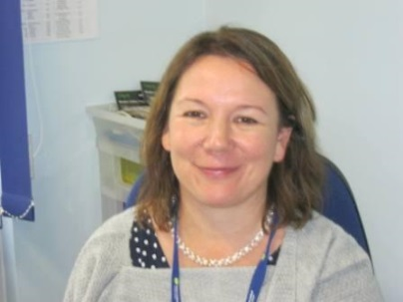
Our Protective Hands
Each child has a protective hand. It lists 5 people they can go to if they are feeling sad or worried.
Each class also has a worry box – this is checked daily.
Our designated safeguarding lead is our head teacher – Miss Lovelock.
Thrive Enjoy Achieve Aspire

Slide 11
What to do if you think your child is being bullied:
Encourage them to speak to an adult in school through use of their protective hand, the worry box in their class or by speaking directly to their teacher.
Make an appointment through the office with your class teacher to voice your concerns. All worries will be taken seriously and investigated.
Thrive Enjoy Achieve Aspire

Slide 12
Our expectations
Good attendance – 97%
Correct uniform and PE kits.
Come to school prepared
Reading journals and spelling books in school every day
Read at home 5 times a week – journal signed by adults.
Practise spellings and KIRFs at home.
Thrive Enjoy Achieve Aspire

Slide 13
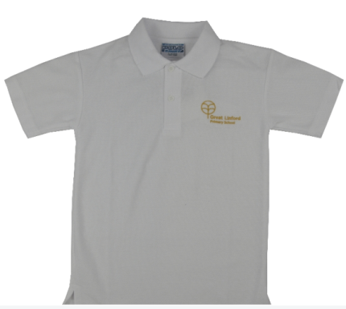
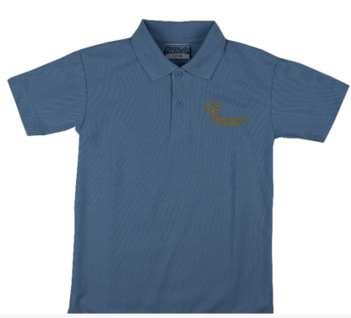
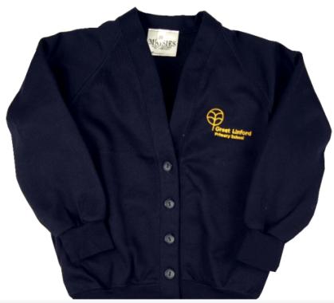
Uniform
Black/Grey trousers/skirt.
Smart black shoes (no trainers)
White or blue shirt/polo
Navy blue cardigan/jumper
No bracelets/necklaces
Earrings must be studs, not hooped.
Note: Windows must be kept open for good ventilation. For this reason, children need a school jumper every day.
Respect all Overcome challenges Open our minds Take care Speak kindly
Notes:
DM

Slide 14
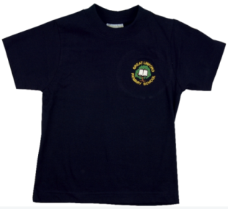
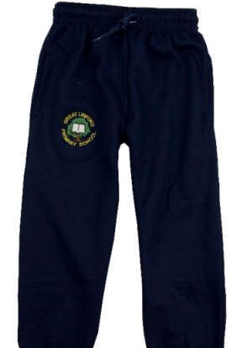
PE Uniform
Navy blue or black trousers/shorts
Blue or white t shirt
Trainers for outdoor PE
Children will need to come dressed in PE kit on
PE days. This must be warm enough to wear outside.
Children must be able to remove or cover earrings for PE. Long hair must be tied up.
PE Days: BOTH classes will have PE on a Friday.
Respect all Overcome challenges Open our minds Take care Speak kindly
Notes:
DM

Slide 15
Home Learning Challenge
Each half term, we will share our home learning activity sheet. Home Learning is split into 3 main categories: arts, STEM (Science Technology Engineering and mathematics) and music. Children can choose to complete one or many of the suggested activities.
Entries can be submitted remotely or handed in.
Please note: Due to Covid-19 guidance, all home learning entries involving singing or wind instruments will have to be pre-recorded rather than live performances.
When is the Home Learning sheet shared? The first week of each half term. Please note autumn 1 will not be released until 14th September 2020.
When is it due in? 2 weeks before the end of half term.
How is work shared? All entries are shared in class and an overall winner is chosen. Winners will be celebrated in the last week of half term in a whole school virtual assembly.
Thrive Enjoy Achieve Aspire

Slide 16
KIRFs
KIRFs – Key Instant Recall Facts
These are maths fluency facts (like times tables or number bonds) that your child should know ‘by heart’.
These will be shared each half term on Google classroom
Practise your KIRFs by playing games, making posters and testing your child.
There are KIRF-linked games available at https://www.greatlinfordprimaryschool.co.uk/maths.html
Children will be given a Numbots username and password. This is a good way to practise times tables at home.
Respect all Overcome challenges Open our minds Take care Speak kindly
Notes:
SS

Slide 17
Spellings
Weekly spellings will be shared on Google classroom.
You will also be given a log in for Spelling Frame
On Spelling Frame, you can play games and practise tests using the spellings you have been given on Google Classroom.
Spellings should be practised at home daily.
Spellings from previous weeks should also continue to be practised so that the spellings become part of childrens’ long term memory rather than being forgotten within a few weeks.
Respect all Overcome challenges Open our minds Take care Speak kindly
Notes:
SS

Slide 18
Expectations - Maths
Count to and across 100 forwards or backwards.
Count in multiples of 2, 5 and 10.
Begin to recall addition and subtraction facts to 20.
Know the place value of each digit in any number up to 100.
Recognise o’clock and half past on an analogue clock.
Thrive Enjoy Achieve Aspire

Slide 19
Expectations - Writing
With increasing accuracy, form lower case letters and the digits 0 -9 in the correct direction.
Read aloud your writing so that peers and teachers can understand the meaning.
Use capital letters for names, places, the days of the week and the personal pronoun ‘I’.
Thrive Enjoy Achieve Aspire

Slide 20
Expectations - Reading
Read aloud – and re read for fluency – books, poems, stories and nonfiction texts that are consistent with your developing phonic knowledge.
Apply phonic knowledge and skills as the key route to decode words, including those of more than one syllable.
Use sounding and blending techniques to attempt previously unseen words.
Be familiar with, and be able to retell, key fairy tales and traditional rhymes or stories.
Explain clearly your understanding of what is read to you: the significance of the title, key events in the text, vocabulary and predictions of what may happen next.
Thrive Enjoy Achieve Aspire

Slide 21
Autumn Term
Our topic: The Adventures of Bear (And Queen- Autumn 2)
We will be learning…
The countries within the United Kingdom
Key facts and history around Queen Elizabeth ||
About historic events in our lives
Thrive Enjoy Achieve Aspire

Slide 22
Spring Term 1
Our topic: Under The Sea
We will be learning…
How to use a map to identify the sea around the United Kingdom
How to use a map to identify the 5 oceans
How to make observations from pictures and videos of costal features
Thrive Enjoy Achieve Aspire

Slide 23
Spring Term 2
Our topic: Sustainability
We will be learning…
How to look after our environment
Different types of energy
Looking at different types of weather in our environment
Thrive Enjoy Achieve Aspire

Slide 24
Summer Term 1
Our Topic: The Highway Rat
Details to be confirmed.
Thrive Enjoy Achieve Aspire

Slide 25
Summer Term 2
Our topic: A Local Study
We will be learning about our local area and the history and geography surrounding us.
Thrive Enjoy Achieve Aspire

Slide 26
Your child’s progress
Autumn parents evening- will be by a telephone appointment
Details around this will follow shortly.
Thrive Enjoy Achieve Aspire

