Slide 1
Year 4
Mrs Lovegood- Year 4 teacher (Year lead)
Mrs Humphris– Year 4 teacher
LSA’s – Tracey, Helen and Kev
Thrive Enjoy Achieve Aspire
Notes:
SS

Slide 2
Thrive
Achieve
Aspire
Enjoy
Respect all Overcome challenges Open our minds Take care Speak kindly
Notes:
SS

Slide 3
Our ROOTS
Respect all people, animals and the environment.
Overcome challenges and never give up.
Open our minds to creativity and curiosity.
Take care of our bodies and our minds.
Speak kindly and listen to others.
Respect all Overcome challenges Open our minds Take care Speak kindly
Notes:
SS

Slide 4
Yellow and Red Leaves
Warning.
Not following our ROOTS.
Still not making the right choices.
Consequence and reflection.
3 red leaves = detention
Respect all Overcome challenges Open our minds Take care Speak kindly
Notes:
DM

Slide 5
Rewards
Aspire trophy
Gold AAB stickers
Gold leaves
House points
Respect all Overcome challenges Open our minds Take care Speak kindly
Notes:
DM

Slide 6
House points
Children have been organised into 3 houses
Children can earn house points throughout the day.
Sports day will be based around the house point system.
Respect all Overcome challenges Open our minds Take care Speak kindly

Slide 7
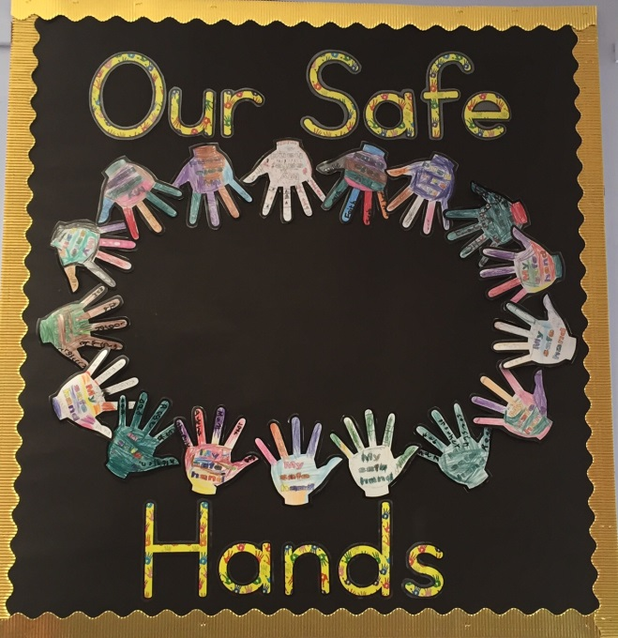
Protective Hands
Every child has a protective hand.
We all have the right to feel safe. Nothing is so awful that you can’t talk to someone about it.
Respect all Overcome challenges Open our minds Take care Speak kindly
Notes:
SS

Slide 8
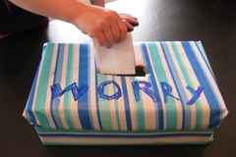
Worry Box
Every class has one.
Children are encouraged to share their worries.
Respect all Overcome challenges Open our minds Take care Speak kindly
Notes:
SS

Slide 9
Bullying
If you are worried that your child is being bullied:
Encourage your child to speak to an adult.
Make an appointment at the office with your class teacher.
Bullying is not tolerated in our school. All concerns will be taken seriously and investigated.
Respect all Overcome challenges Open our minds Take care Speak kindly
Notes:
SS

Slide 10
Communication
Parent Gateway – ensure you are registered.
Home reading journal.
Call the office to make appointment.
Information is on our website.
We also have a Facebook page and twitter as well as a facebook group.
Respect all Overcome challenges Open our minds Take care Speak kindly
Notes:
SS

Slide 11
Safeguarding
Miss Tara Lovelock – our designated safeguarding lead.
Miss Kerrigan, Mrs Mallett and Julie are also part of the safeguarding team.
Respect all Overcome challenges Open our minds Take care Speak kindly
Notes:
SS

Slide 12
Our expectations
Correct uniform (which is labelled)
Come to school prepared
Reading journal and spelling book in school every day
Children reading at home 5 times per week to an adult (or older sibling)
PE kit in school on PE days
Home Learning is optional but encouraged
Respect all Overcome challenges Open our minds Take care Speak kindly
Notes:
DM

Slide 13
Home learning
Half termly - Piece of music, artwork, poem, famous person linked to our topics.
Children choose from a range of tasks at their own chosen level.
Children may complete as many or as few of the tasks as they would like to.
Last Monday of term – children share in class and receive feedback from the teacher and peers.
One child selected per class to present in assembly.
Respect all Overcome challenges Open our minds Take care Speak kindly
Notes:
SS

Slide 14
KIRFs and Spellings
KIRFs – Key Instant Recall Facts
Half termly
Maths facts for your child to learn at home.
Weekly KIRF activities listed to help you practise.
Spellings – go home on a Monday.
Spelling tests are on a Monday.
Spelling activities listed to help you practise in spelling books.
Respect all Overcome challenges Open our minds Take care Speak kindly
Notes:
SS

Slide 15
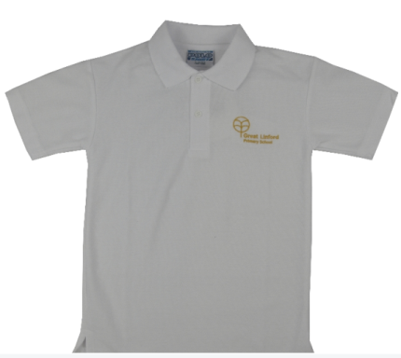
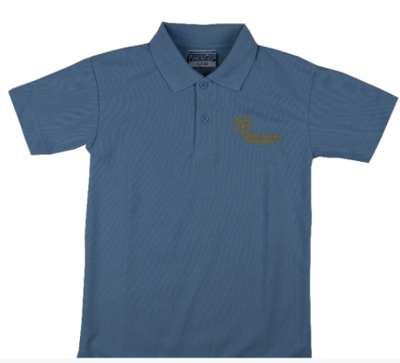
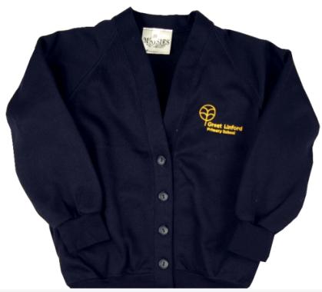
Uniform
Black/Grey trousers/skirt.
Black shoes (no trainers)
White or blue shirt/polo
Navy blue cardigan/jumper
No bracelets/necklaces
Earrings must be studs, not hooped and will
need to be removed or covered for
PE/swimming.
Respect all Overcome challenges Open our minds Take care Speak kindly
Notes:
DM

Slide 16
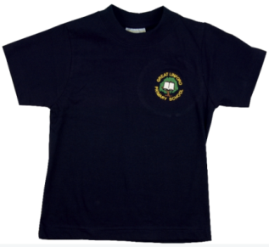
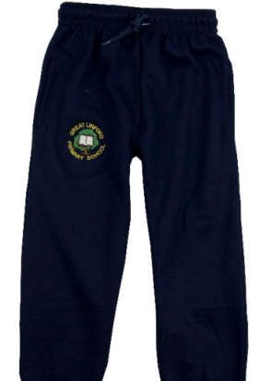
PE Uniform
navy blue trousers/shorts
Navy blue t shirt/jumper
Trainers for outdoor PE
We will go out in most weathers – please bring weather appropriate PE kits
PE dates TBC – check class pages on the website
for more information.
Respect all Overcome challenges Open our minds Take care Speak kindly
Notes:
DM

Slide 17
Swimming
Mrs Lovegood’s class will swim every Friday during Autumn.
Mrs Humphris’ class will swim every Friday during Spring.
Children will need a one piece swimming costume/trunks, a towel and a swimming hat.
Children with a verruca will need a verruca sock/plaster.
Respect all Overcome challenges Open our minds Take care Speak kindly
Notes:
DM

Slide 18
Year 4
Curriculum expectations sheet outlines what your child should be able to achieve in year 4.
See our website for more information about expectations for other year groups.
Respect all Overcome challenges Open our minds Take care Speak kindly
Notes:
DM

Slide 19
This half term:
The Elizabethans:
The Devil and his boy – Anthony Horrowitz
Elizabeth 1st and Mary Queen of Scots
Comparing life during Elizabethan era to now
Respect all Overcome challenges Open our minds Take care Speak kindly
Notes:
DM

Slide 20
Autumn 2
Ancient Greece:
Greek Myths – Marcia Williams
Greek culture – foods, music, democracy, art
Greek wars and battles (Battle of Marathon)
Respect all Overcome challenges Open our minds Take care Speak kindly
Notes:
DM

Slide 21
Spring:
Rainforests
Running Wild by Michael Morpurgo
Deforestation/protecting the environment
Layers of the forest and animal/plant life.
Dependency of animals on the forest
Respect all Overcome challenges Open our minds Take care Speak kindly
Notes:
DM

Slide 22
Spring:
The Romans are coming:
Romans on the Rampage – Jeremy Strong
Roman invasion
Boudicca
Comparing life then and now
Respect all Overcome challenges Open our minds Take care Speak kindly
Notes:
DM

Slide 23
Summer:
Magical Worlds:
Harry Potter and the Philosopher’s Stone
Trip to Wizarding World of Harry Potter
DT project using cams and cranks
Respect all Overcome challenges Open our minds Take care Speak kindly
Notes:
DM

Slide 24
Summer:
Journeys on foot:
The building of canals
Linked to our local area
Local area studies/walks
Respect all Overcome challenges Open our minds Take care Speak kindly
Notes:
DM

Slide 25
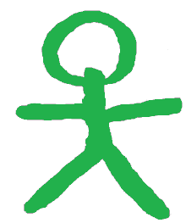
Respect all Overcome challenges Open our minds Take care Speak kindly
How we grow our learning
Gold
’Got it’
Green
‘Grow it’
I grew my learning
I grew my learning
with a friend
// new paragraph Vf Verbal feedback
W spelling mistake I Independent
 missing capital letter GG Guided group
W! punctuation error TA Teaching assistant
Notes:
SS

Slide 26
Information on Progress
Autumn and Spring parents evenings-
October and February
End of year written report
Any other meetings can be booked via the office.
Respect all Overcome challenges Open our minds Take care Speak kindly

